Slide 1
What states Benefit from Federal food assistance programs the most, and does it affect obesity/diabetes?
By: Group Name Here
Allison, Clint, Henry, Zahra

Slide 2
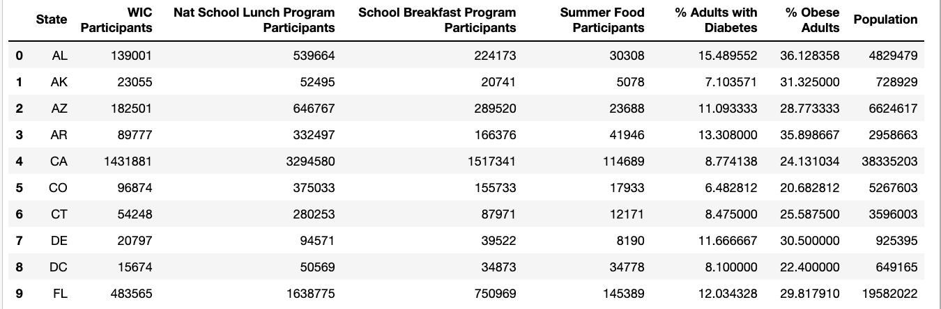
Data Snapshot

Slide 3

Questions

Slide 4
Which ten states have the most WIC participants, based on population?
Which ten states have the most School Breakfast Program participants, based on population?
Which ten states have the most School Lunch Program participants, based on population?
Which ten states have the highest diabetes and obesity rates, based on population?

Slide 5
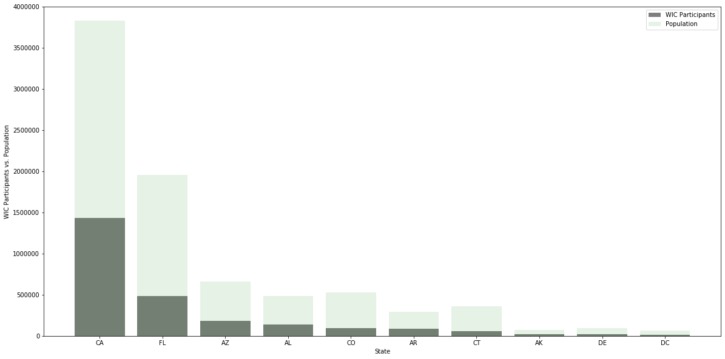
WIC Participation Vs Population
The ten states with the most WIC Participants:
California 3.73%, Florida 2.47%, Arizona 2.75%, Alabama 2.88%, Colorado 1.83%, Arkansas 3.03%, Connecticut 1.50%, Alaska 3.16%, Delaware 2.25%, District of Columbia 2.41%
Percentages in participants by population

Slide 6
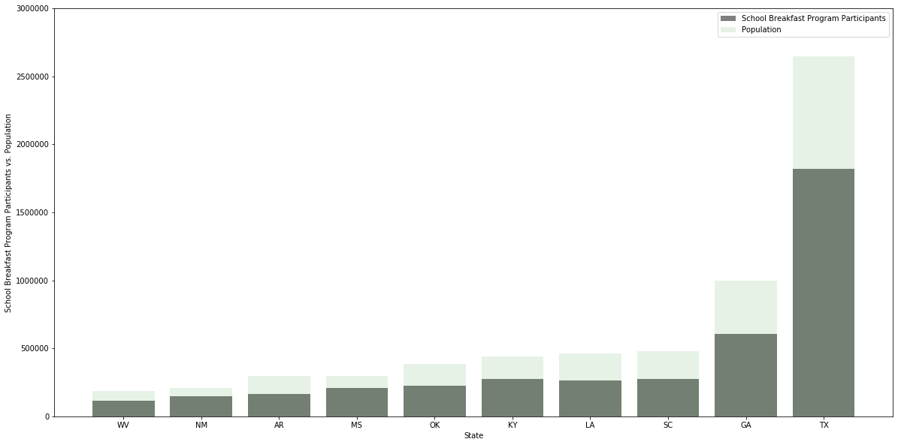
School Breakfast Program Participants Vs Population
The ten states with the most School Breakfast Program Participants:
New Mexico 7.11%, Mississippi 6.93%, Texas 6.87%, West Virginia 6.31%, Kentucky 6.29%, Georgia 6.09%, Oklahoma 5.91%, Louisiana 5.74%, South Carolina 5.74%, Arkansas 5.62%
Percentages in participants by population

Slide 7
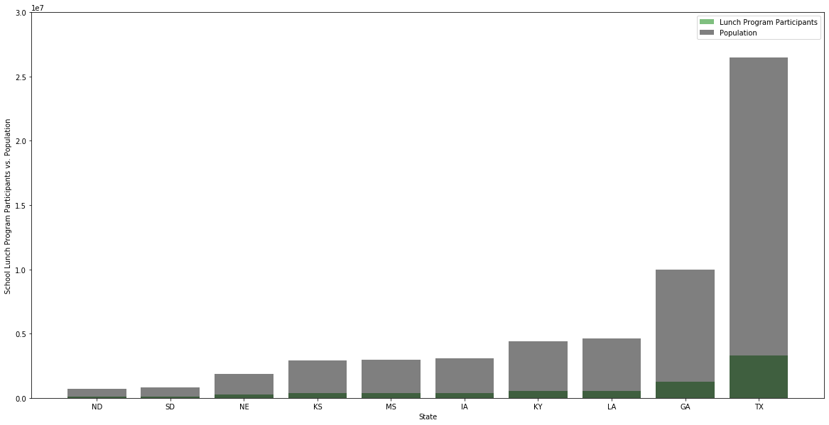
School Lunch Program Participants Vs Population
The Ten States with the most Lunch Program Participants are:
North Dakota 12.03%, South Dakota 12.8%, Nebraska 13%, Kansas 12.02%, Mississippi 13.1%, Iowa 12.43%, Kentucky 12.1%, Louisiana 12.2%, Georgia 12.5%, Texas 12.52%
Percentages in participants by population

Slide 8
Top 10 states for diabetes: GA (12.68%); OH (12.43%); NC (12.32%); FL (12%); mi (11.37%); PA (11.28%); IL (10.51%); TX (10.39%); NY (9.63%); CA (8.77%)
Association between obesity
and diabetes
Top 10 states for OBESITY:
OH (32.83%);
mi (32.1%); NC (31.5%); PA (31.45%);
GA (31.4%); IL (30%); FL (29.82%); TX (28.7%); NY (27.52%); CA (24.1%)
Based on population n and percentage of diabetes and obesity within each state, we can loosely associate the two chronic diseases with one another. We cannot claim to say the same individuals who are considered obese, also have diabetes.
Additional research will need to be done with patient-level data to link across diseases and ascertain whether one causes the other over time, increased risk for one if you are diagnosed with the other.

Slide 9
Summary
States for obesity
OH, MI, NC, PA, GA, IL, FL, TX, NY, CA
States for diabetes
GA, OH, NC, FL, MI, PA, IL, TX, NY, CA
Lunch
ND, SD, NE, KS, MS, IA, KY, LA, GA, TX
Bkfast
NM, MS, TX, WV, KY, GA, OK, LA, SC, AR
WIC
CA, FL, AZ, AL, CO, AR, CT, AK, DE, DC
Based on the data there seems to be a direct correlation between obesity and diabetes, however, there doesn’t seem to be a correlation between the supplemental food programs and ”food based disease”

